Slide 1
Chapter 10
File System Interface

Slide 2
Chapter 10: File System Interface
10.1 File Concept
10.2 Access Methods
10.3 Directory Structure
10.4 File-System Mounting
10.6 File sharing and Protection

Slide 3
Objectives
To explain the function of file systems
To describe the interfaces to file systems
To discuss file-system design tradeoffs, including access methods, file sharing, file locking, and directory structures
To explore file-system protection

Slide 4
10.1 File Concept

Slide 5
Introduction
Computers can store information on various storage media
The operating system abstracts from the physical properties of its storage devices to define a logical storage unit called a file
Files are mapped by the operating system onto nonvolatile physical devices
A file is a named collection of related information that is recorded on secondary storage
For a user’s perspective, a file is the smallest allotment of logical secondary storage (i.e., data supposedly cannot be written to secondary storage unless written in a file)‏
Files commonly represent programs (both source and object code) and data
Data file contents may be numeric, alphabetic, alphanumeric, or binary
Files may be free form (e.g., text files) or rigidly formatted
In general, a file is a sequence of bits, bytes, lines, or records, whose meaning is defined by the file’s creator and user

Slide 6
File Structure
A file has a certain defined structure, which depends on its type
A text file is a sequence of characters organized into lines
A source code file is a sequence of declarations, statements, and subroutine definitions
An object code file and an executable file each contain a sequence of bytes organized into headers and tables of data and code understandable by a system linker and loader
A file is named for the convenience of its human users, and is referred to by its name
After a file is created, it becomes independent of the process that created it; other processes may read it or edit it

Slide 7
File Attributes
Name – the only information kept in human-readable form
Identifier – unique tag (a number) that identifies file within the file system
Type – used by systems that support different types of files
Location – pointer to file location on a device
Size – current file size in bytes, words, or blocks
Protection – access controls for who can read, write, and execute
Time, date, and user identification – used for documenting file creation, last modification, and last use
Information about all files is kept in the directory structure, which also is located on secondary storage

Slide 8
File Operations
A file is an abstract data type with operations to
  Create
  Write
  Read
  Reposition within file
  Delete
  Truncate (i.e., erase the contents but keep the file)‏

Slide 9
Open Files
Several pieces of data are needed to manage open files:
  File pointer: pointer to last read/write location; unique to each process that has the file open
  File-open count: count of number of simultaneous opens for a file to allow removal of the file entry from the open-file table when the last process closes it
  Disk location of the file: Information kept in memory and used to locate the file on disk
  Access rights: Access mode information stored for each process

Slide 10
Open File Locking
Provided by some operating systems and file systems
  Shared lock – Read lock
  Exclusive lock
Mediates access to a file
Mandatory or advisory:
  Mandatory – access is denied depending on locks held and requested
    Once a process acquires an exclusive lock, the OS will prevent any other process to access the locked file.
  Advisory – processes can find status of locks and decide what to do
    Up to software developers to ensure the locks are appropriately aquired or released.

Slide 11

File Types – Name, Extension

Slide 12
10.2 Access Methods

Slide 13
Access Methods
Sequential Access
read next
write next
reset
skip forward
skip backward
Direct Access
read n
write n
position to n
n = relative block number
Indexed Access

Slide 14

Sequential-access File

Slide 15
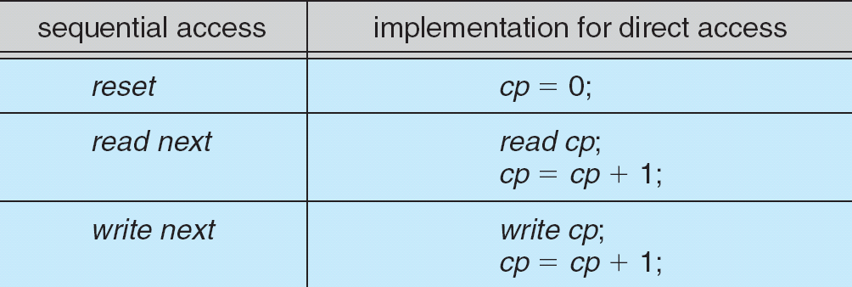
Simulation of Sequential Access on a Direct-access File
cp = current position

Slide 16

Example of Index and Relative Files

Slide 17
10.3 Directory Structure

Slide 18
Directory Structure
A collection of nodes containing information about all files
Directory
Files
F 1
F 2
F 3
F 4
F n
Both the directory structure and the files reside on disk. Backups of these two structures may be kept on tapes.

Slide 19

A Typical File-system Organization

Slide 20
Operations Performed on Directory
Search for a file
Create a file
Delete a file
List a directory
Rename a file
Traverse the file system

Slide 21
Goal: Organize a directory (logically) based on the following criteria:
Efficiency – locating a file quickly
Naming – convenient to users
  Two users can have same name for different files
  The same file can have several different names
Grouping – logical grouping of files by properties, (e.g., all Java programs, all games, …)‏

Slide 22
Four Possible Approaches
Single-level Directory
Two-level Directory
Tree-structured Directories
Acyclic Graph Directories

Slide 23

Single-Level Directory
A single directory maintained for all users
Advantages
  Efficiency
Disadvantages
  Naming - collisions
  Grouping – not possible

Slide 24

Two-Level Directory
Separate directory for each user
Advantages
  Efficient searching
  Naming - same file name in a different directory; path name
Disadvantages
  Naming - collisions
  Grouping capability – not possible except by user

Slide 25

Tree-Structured Directories

Slide 26
Tree-Structured Directories (Cont)‏
Advantages
  Efficient searching – current working directory
  Naming - same file name in a different directory
  Grouping capability
Disadvantages
  Structural complexity

Slide 27
Tree-Structured Directories (Cont)‏
Absolute or relative path name
Creating a new file is done in current directory
Delete a file
rm <file-name>
Creating a new subdirectory is done in current directory
  mkdir <dir-name>
Example: if in current directory /mail
mkdir count
mail
prog
copy
prt
exp
count

Slide 28

Acyclic-Graph Directories
Have shared subdirectories and files

Slide 29
Acyclic-Graph Directories (Cont.)‏
Same advantages as tree-structured directory
  In addition, the same file or directory may have a reference that appears in two or more directories
Disadvantage is that its structure is more complex
  The same file or directory may be referred to by many names
  Need to be cautious of dangling pointers when files are deleted
Solutions to deletion
  Just delete the link
  Preserve the file until all links (i.e., references) are deleted
This requires a new directory entry type called a link
  Keep a count of the number of references

Slide 30
10.4 File System Mounting

Slide 31
File System Mounting
A file system must be mounted before it can be accessed
An unmounted file system is mounted at a mount point (see the next two slides)‏

Slide 32

(a) Existing. (b) Unmounted Partition
See result of this mounting
on the next slide

Slide 33
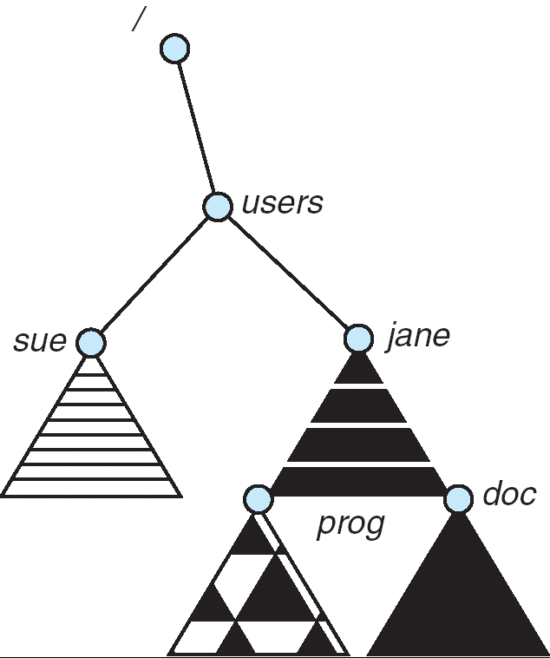
Mount Point

Slide 34
Common Mount Points
Unix or Linux – any directory
  / - root directory
  /floppy – floppy drive
  /cdrom – cdrom drive
  /dev – device “drivers”
  /home – user directories
Windows XP – drive letters (examples only)‏
  A:, B: - floppy drive
  C: - hard drive
  D: - CD-ROM drive
  E: - USB drive
  F: - network drive

Slide 35
10.6 File Protection

Slide 36
Protection
File owner/creator should be able to control:
  what can be done to a file
  by whom
Types of access
  Read
  Write
  Execute
  Append
  Delete
  List

Slide 37
Access Lists and Groups
Mode of access: read, write, execute
Three classes of users
RWX
a) owner access 7 ⇒ 1 1 1
RWX
b) group access 6 ⇒ 1 1 0
RWX
c) public access 1 ⇒ 0 0 1
A system administrator creates a group (unique name), say G, and adds some users to the group.
For a particular file (say game) or subdirectory, define an appropriate access.
owner
group
public
chmod
761
game
Attach a group to a file
chgrp G game

Slide 38

Windows XP Access-control List Management

Slide 39

A Sample UNIX Directory Listing

Slide 40
End of Chapter 10

